Slide 1
Statistical Natural Language Parsing
Two views of syntactic structure

Slide 2
Two views of linguistic structure:
1. Constituency (phrase structure)
Phrase structure organizes words into nested constituents.
How do we know what is a constituent? (Not that linguists don’t argue about some cases.)
  Distribution: a constituent behaves as a unit that can appear in different places:
    John talked [to the children] [about drugs].
    John talked [about drugs] [to the children].
    *John talked drugs to the children about
  Substitution/expansion/pro-forms:
    I sat [on the box/right on top of the box/there].
  Coordination, regular internal structure, no intrusion, fragments, semantics, …
Notes:
Use Fed raises interest rates example.

Slide 3
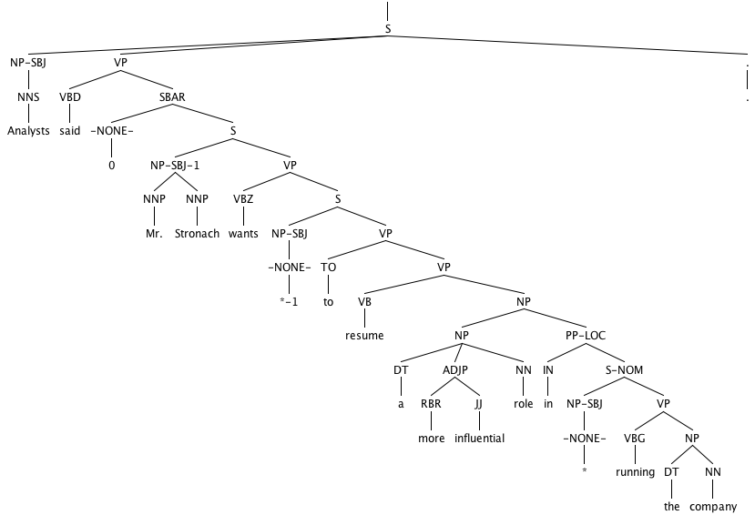

Slide 4
Headed phrase structure
VP → … VB* …
NP → … NN* …
ADJP → … JJ* …
ADVP → … RB* …
SBAR(Q) → S|SINV|SQ → … NP VP …
Plus minor phrase types:
  QP (quantifier phrase in NP), CONJP (multi word constructions: as well as), INTJ (interjections), etc.

Slide 5
Two views of linguistic structure:
2. Dependency structure
Dependency structure shows which words depend on (modify or are arguments of) which other words.
put
boy
tortoise
on
The
the
rug
The
boy
put
the
tortoise
on
the
rug
the

Slide 6
Statistical Natural Language Parsing
Two views of syntactic structure

Slide 7
Statistical Natural Language Parsing
Parsing: The rise of data and statistics

Slide 8
Pre 1990 (“Classical”) NLP Parsing
Wrote symbolic grammar (CFG or often richer) and lexicon
  S → NP VP NN → interest
  NP → (DT) NN NNS → rates
  NP → NN NNS NNS → raises
  NP → NNP VBP → interest
  VP → V NP VBZ → rates
Used grammar/proof systems to prove parses from words
This scaled very badly and didn’t give coverage. For sentence:
Fed raises interest rates 0.5% in effort to control inflation
  Minimal grammar: 36 parses
  Simple 10 rule grammar: 592 parses
  Real-size broad-coverage grammar: millions of parses

Slide 9
Classical NLP Parsing:
The problem and its solution
Categorical constraints can be added to grammars to limit unlikely/weird parses for sentences
  But the attempt make the grammars not robust
    In traditional systems, commonly 30% of sentences in even an edited text would have no parse.
A less constrained grammar can parse more sentences
  But simple sentences end up with ever more parses with no way to choose between them
We need mechanisms that allow us to find the most likely parse(s) for a sentence
  Statistical parsing lets us work with very loose grammars that admit millions of parses for sentences but still quickly find the best parse(s)

Slide 10
The rise of annotated data:
The Penn Treebank
[Marcus et al. 1993, Computational Linguistics]
( (S
(NP-SBJ (DT The) (NN move))
(VP (VBD followed)
(NP
(NP (DT a) (NN round))
(PP (IN of)
(NP
(NP (JJ similar) (NNS increases))
(PP (IN by)
(NP (JJ other) (NNS lenders)))
(PP (IN against)
(NP (NNP Arizona) (JJ real) (NN estate) (NNS loans))))))
(, ,)
(S-ADV
(NP-SBJ (-NONE- *))
(VP (VBG reflecting)
(NP
(NP (DT a) (VBG continuing) (NN decline))
(PP-LOC (IN in)
(NP (DT that) (NN market)))))))
(. .)))

Slide 11
The rise of annotated data
Starting off, building a treebank seems a lot slower and less useful than building a grammar
But a treebank gives us many things
  Reusability of the labor
    Many parsers, POS taggers, etc.
    Valuable resource for linguistics
  Broad coverage
  Frequencies and distributional information
  A way to evaluate systems

Slide 12
Statistical Natural Language Parsing
Parsing: The rise of data and statistics

Slide 13
A phrase structure grammar
S → NP VP
VP → V NP
VP → V NP PP
NP → NP NP
NP → NP PP
NP → N
NP → e
PP → P NP
people fish tanks
people fish with rods
N → people
N → fish
N → tanks
N → rods
V → people
V → fish
V → tanks
P → with

Slide 14
Phrase structure grammars
= context-free grammars (CFGs)
G = (T, N, S, R)
  T is a set of terminal symbols
  N is a set of nonterminal symbols
  S is the start symbol (S ∈ N)
  R is a set of rules/productions of the form X → γ
    X ∈ N and γ ∈ (N ∪ T)*
A grammar G generates a language L.
Notes:
γ is a sequence of terminals and/or nonterminals (possibly an empty sequence)

Slide 15
Phrase structure grammars in NLP
G = (T, C, N, S, L, R)
  T is a set of terminal symbols
  C is a set of preterminal symbols
  N is a set of nonterminal symbols
  S is the start symbol (S ∈ N)
  L is the lexicon, a set of items of the form X → x
    X ∈ P and x ∈ T
  R is the grammar, a set of items of the form X → γ
    X ∈ N and γ ∈ (N ∪ C)*
By usual convention, S is the start symbol, but in statistical NLP, we usually have an extra node at the top (ROOT, TOP)
We usually write e for an empty sequence, rather than nothing
Notes:
γ is a sequence of terminals and/or nonterminals (possibly an empty sequence)

Slide 16
A phrase structure grammar
S → NP VP
VP → V NP
VP → V NP PP
NP → NP NP
NP → NP PP
NP → N
NP → e
PP → P NP
people fish tanks
people fish with rods
N → people
N → fish
N → tanks
N → rods
V → people
V → fish
V → tanks
P → with

Slide 17
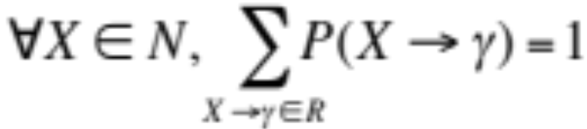
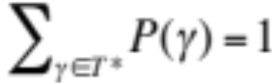
Probabilistic – or stochastic – context-free grammars (PCFGs)
G = (T, N, S, R, P)
  T is a set of terminal symbols
  N is a set of nonterminal symbols
  S is the start symbol (S ∈ N)
  R is a set of rules/productions of the form X → γ
  P is a probability function
    P: R → [0,1]
A grammar G generates a language model L.
Notes:
P gives the probability of each rule.

Slide 18

A PCFG
S → NP VP 1.0
VP → V NP 0.6
VP → V NP PP 0.4
NP → NP NP 0.1
NP → NP PP 0.2
NP → N 0.7
PP → P NP 1.0
N → people 0.5
N → fish 0.2
N → tanks 0.2
N → rods 0.1
V → people 0.1
V → fish 0.6
V → tanks 0.3
P → with 1.0
[With empty NP removed so less ambiguous]
Notes:
Clipart: http://www.wpclipart.com/animals/aquatic/fish/_happy_fish.png.html
Public domain.

Slide 19
The probability of trees and strings
P(t) – The probability of a tree t is the product of the probabilities of the rules used to generate it.
P(s) – The probability of the string s is the sum of the probabilities of the trees which have that string as their yield
  P(s) = Σ_{j} P(s, t) where t is a parse of s
= Σ_{j} P(t)

Slide 20
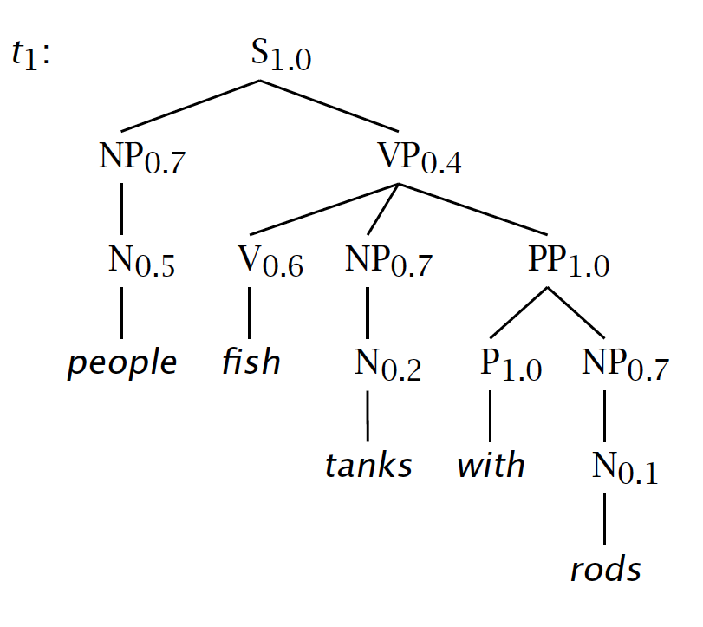

Slide 21
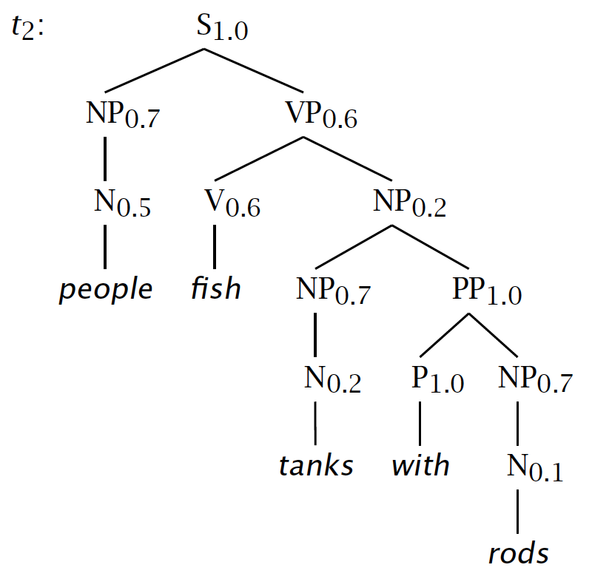

Slide 22
Tree and String Probabilities
s = people fish tanks with rods
P(t₁) = 1.0 × 0.7 × 0.4 × 0.5 × 0.6 × 0.7
× 1.0 × 0.2 × 1.0 × 0.7 × 0.1
= 0.0008232
P(t₂) = 1.0 × 0.7 × 0.6 × 0.5 × 0.6 × 0.2
× 0.7 × 1.0 × 0.2 × 1.0 × 0.7 × 0.1
= 0.00024696
P(s) = P(t₁) + P(t₂)
= 0.0008232 + 0.00024696
= 0.00107016
Verb attach
Noun attach

Slide 23
Notes:
Say that VP is 3 1/3 more times more likely because it’s 0.4 vs. 0.6 x 0.2
Say how you might think how this makes PCFGs very sensitive to how flat or deep trees are. We’ll return to that.

Slide 25
CFGs and PCFGs
(Probabilistic) Context-Free Grammars

Slide 26
Grammar
Transforms
Restricting the grammar form for efficient parsing

Slide 27
Chomsky Normal Form
All rules are of the form X → Y Z or X → w
  X, Y, Z ∈ N and w ∈ T
A transformation to this form doesn’t change the weak generative capacity of a CFG
  That is, it recognizes the same language
    But maybe with different trees
Empties and unaries are removed recursively
n-ary rules are divided by introducing new nonterminals (n > 2)

Slide 28
A phrase structure grammar
S → NP VP
VP → V NP
VP → V NP PP
NP → NP NP
NP → NP PP
NP → N
NP → e
PP → P NP
N → people
N → fish
N → tanks
N → rods
V → people
V → fish
V → tanks
P → with
Notes:
Start discussing epsilon removal

Slide 29
Chomsky Normal Form steps
S → NP VP
S → VP
VP → V NP
VP → V
VP → V NP PP
VP → V PP
NP → NP NP
NP → NP
NP → NP PP
NP → PP
NP → N
PP → P NP
PP → P
N → people
N → fish
N → tanks
N → rods
V → people
V → fish
V → tanks
P → with
Notes:
Start discussing unary removal downwards: remove S → VP

Slide 30
Chomsky Normal Form steps
S → NP VP
VP → V NP
S → V NP
VP → V
S → V
VP → V NP PP
S → V NP PP
VP → V PP
S → V PP
NP → NP NP
NP → NP
NP → NP PP
NP → PP
NP → N
PP → P NP
PP → P
N → people
N → fish
N → tanks
N → rods
V → people
V → fish
V → tanks
P → with
Notes:
Remove more unaries, next S → V

Slide 31
Chomsky Normal Form steps
S → NP VP
VP → V NP
S → V NP
VP → V
VP → V NP PP
S → V NP PP
VP → V PP
S → V PP
NP → NP NP
NP → NP
NP → NP PP
NP → PP
NP → N
PP → P NP
PP → P
N → people
N → fish
N → tanks
N → rods
V → people
S → people
V → fish
S → fish
V → tanks
S → tanks
P → with
Notes:
After remove S → V get this, and then do VP → V

Slide 32
Chomsky Normal Form steps
S → NP VP
VP → V NP
S → V NP
VP → V NP PP
S → V NP PP
VP → V PP
S → V PP
NP → NP NP
NP → NP
NP → NP PP
NP → PP
NP → N
PP → P NP
PP → P
N → people
N → fish
N → tanks
N → rods
V → people
S → people
VP → people
V → fish
S → fish
VP → fish
V → tanks
S → tanks
VP → tanks
P → with
Notes:
Remove more unaries, next NP → NP (easy, cross-it-off) and then NP → N.
Since this is the only place N appears on the RHS of a grammar rule, we can delete it from our set of nonterminals altogether.
Then NP → PP and PP → P

Slide 33
Chomsky Normal Form steps
S → NP VP
VP → V NP
S → V NP
VP → V NP PP
S → V NP PP
VP → V PP
S → V PP
NP → NP NP
NP → NP PP
NP → P NP
PP → P NP
NP → people
NP → fish
NP → tanks
NP → rods
V → people
S → people
VP → people
V → fish
S → fish
VP → fish
V → tanks
S → tanks
VP → tanks
P → with
PP → with
Notes:
And then binarize

Slide 34
Chomsky Normal Form steps
S → NP VP
VP → V NP
S → V NP
VP → V @VP_V
@VP_V → NP PP
S → V @S_V
@S_V → NP PP
VP → V PP
S → V PP
NP → NP NP
NP → NP PP
NP → P NP
PP → P NP
NP → people
NP → fish
NP → tanks
NP → rods
V → people
S → people
VP → people
V → fish
S → fish
VP → fish
V → tanks
S → tanks
VP → tanks
P → with
PP → with
Notes:
Chomsky Normal form!

Slide 35
A phrase structure grammar
S → NP VP
VP → V NP
VP → V NP PP
NP → NP NP
NP → NP PP
NP → N
NP → e
PP → P NP
N → people
N → fish
N → tanks
N → rods
V → people
V → fish
V → tanks
P → with
Notes:
Now, if a linguist hands you this

Slide 36
Chomsky Normal Form steps
S → NP VP
VP → V NP
S → V NP
VP → V @VP_V
@VP_V → NP PP
S → V @S_V
@S_V → NP PP
VP → V PP
S → V PP
NP → NP NP
NP → NP PP
NP → P NP
PP → P NP
NP → people
NP → fish
NP → tanks
NP → rods
V → people
S → people
VP → people
V → fish
S → fish
VP → fish
V → tanks
S → tanks
VP → tanks
P → with
PP → with
Notes:
and you hand them back this, then they tend not to be very happy.

Slide 37
Chomsky Normal Form
You should think of this as a transformation for efficient parsing
With some extra book-keeping in symbol names, you can even reconstruct the same trees with a detransform
In practice full Chomsky Normal Form is a pain
  Reconstructing n-aries is easy
  Reconstructing unaries/empties is trickier
Binarization is crucial for cubic time CFG parsing
The rest isn’t necessary; it just makes the algorithms cleaner and a bit quicker

Slide 38
An example: before binarization…
ROOT
S
NP
VP
V
NP
PP
N
P
NP
N
N
people
fish
tanks
with
rods

Slide 39
After binarization…
ROOT
S
NP
VP
@VP_V
N
V
NP
PP
N
P
NP
N
people
fish
tanks
with
rods

Slide 40
Treebank: empties and unaries
ROOT
ROOT
ROOT
ROOT
ROOT
S-HLN
S
S
S
NP-SUBJ
VP
NP
VP
VP
-NONE-
VB
-NONE-
VB
VB
VB
e
Atone
e
Atone
Atone
Atone
Atone
PTB Tree
NoFuncTags
NoEmpties
High
Low
NoUnaries

Slide 41
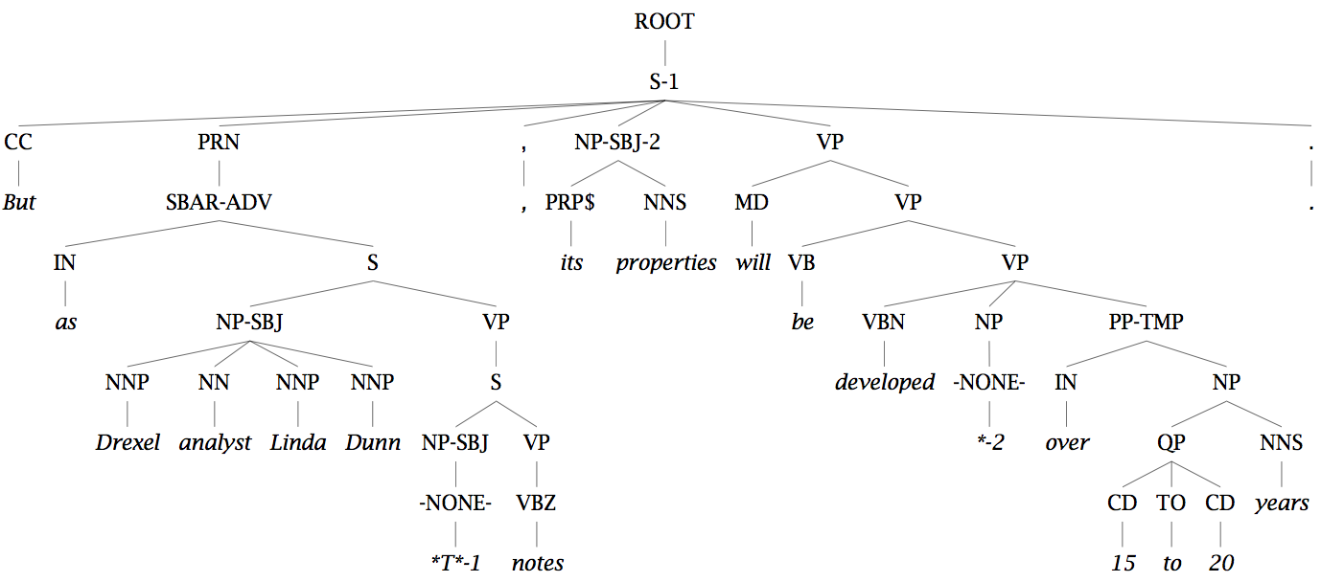
Unary rules: alchemy in the land of treebanks

Slide 42
Same-Span Reachability
TOP
NoEmpties
NX
SQ
X
RRC
LST
ADJP ADVP
FRAG INTJ NP
PP PRN QP S
SBAR UCP VP
WHNP
CONJP
NAC
SINV
PRT
SBARQ
WHADJP
WHPP
WHADVP
Notes:
SCC: Strongly connected component.

Slide 43
Grammar
Transforms
Restricting the grammar form for efficient parsing

Slide 44
CKY Parsing
Exact polynomial time parsing of
(P)CFGs

Slide 45
Constituency Parsing
PCFG
fish people fish tanks
Rule Prob θ_{i}
S → NP VP θ₀
NP → NP NP θ₁
…
N → fish θ₄₂
N → people θ₄₃
V → fish θ₄₄
…
S
VP
NP
NP
N
N
V
N
Notes:
Want to work out all possible structures licensed by grammar.
In PCFG want to find the highest probability one.
Without doing any repeated work.
Probs for all rules with the same parent sum to 1.
Prob of a parse is product of probs of all the rules
Probs estimated by reading counts off of the treebank - it’s a generative model

Slide 46
Cocke-Kasami-Younger (CKY)
Constituency Parsing
fish people fish tanks

Slide 47
Viterbi (Max) Scores
NP→NN NNS 0.13
i_{NP} = (0.13)(0.0023)(0.0014)
= 1.87 × 10⁻⁷
NP→NNP NNS 0.056
i_{NP} = (0.056)(0.001)(0.0014)
= 7.84 × 10⁻⁸
S 1.87 × 10⁻⁷
VP
VP 0.06
NP 0.14
V 0.6
N 0.2
NP 0.35
V 0.1
N 0.5
people fish

Slide 48
Viterbi (Max) Scores
S → NP VP 0.9
S → VP 0.1
VP → V NP 0.5
VP → V 0.1
VP → V @VP_V 0.3
VP → V PP 0.1
@VP_V → NP PP 1.0
NP → NP NP 0.1
NP → NP PP 0.2
NP → N 0.7
PP → P NP 1.0
VP 0.06
NP 0.14
V 0.6
N 0.2
NP 0.35
V 0.1
N 0.5
people fish
Notes:
NP -> NP NP = 0.35 * 0.14 * 0.1 = 0.0049
VP -> V NP = 0.1 * 0.14 * 0.5 = 0.007
S -> VP = 0.007 * 0.1 = 0.0007
S -> NP VP = 0.35 * 0.06 * 0.9 = 0.0189

Slide 49
Extended CKY parsing
Unaries can be incorporated into the algorithm
  Messy, but doesn’t increase algorithmic complexity
Empties can be incorporated
  Use fenceposts
  Doesn’t increase complexity; essentially like unaries
Binarization is vital
  Without binarization, you don’t get parsing cubic in the length of the sentence and in the number of nonterminals in the grammar
    Binarization may be an explicit transformation or implicit in how the parser works (Early-style dotted rules), but it’s always there.

Slide 50
The CKY algorithm (1960/1965)
… extended to unaries
  function CKY(words, grammar) returns [most_probable_parse,prob]
  score = new double[#(words)+1][#(words)+1][#(nonterms)]
  back = new Pair[#(words)+1][#(words)+1][#nonterms]]
  for i=0; i<#(words); i++
  for A in nonterms
  if A -> words[i] in grammar
  score[i][i+1][A] = P(A -> words[i])
  //handle unaries
  boolean added = true
  while added
  added = false
  for A, B in nonterms
  if score[i][i+1][B] > 0 && A->B in grammar
  prob = P(A->B)*score[i][i+1][B]
  if prob > score[i][i+1][A]
  score[i][i+1][A] = prob
  back[i][i+1][A] = B
  added = true

Slide 51
The CKY algorithm (1960/1965)
… extended to unaries
  for span = 2 to #(words)
  for begin = 0 to #(words)- span
  end = begin + span
  for split = begin+1 to end-1
  for A,B,C in nonterms
prob=score[begin][split][B]*score[split][end][C]*P(A->BC)
  if prob > score[begin][end][A]
  score[begin]end][A] = prob
  back[begin][end][A] = new Triple(split,B,C)
  //handle unaries
  boolean added = true
  while added
  added = false
  for A, B in nonterms
  prob = P(A->B)*score[begin][end][B];
  if prob > score[begin][end][A]
  score[begin][end][A] = prob
  back[begin][end][A] = B
  added = true
  return buildTree(score, back)

Slide 52
Quiz Question!
PP → IN 0.002
NP → NNS NNS 0.01
NP → NNS NP 0.005
NP → NNS PP 0.01
VP → VB PP 0.045
VP → VB NP 0.015
?? ??
?? ??
PP 0.2
IN 0.0014
NNS 0.0001
NNS 0.0023
VB 0.001
What constituents (with what probability can you make?
runs down

Slide 53
CKY Parsing
Exact polynomial time parsing of
(P)CFGs

Slide 54
CKY Parsing
A worked example

Slide 55
The grammar:
Binary, no epsilons,
S → NP VP 0.9
S → VP 0.1
VP → V NP 0.5
VP → V 0.1
VP → V @VP_V 0.3
VP → V PP 0.1
@VP_V → NP PP 1.0
NP → NP NP 0.1
NP → NP PP 0.2
NP → N 0.7
PP → P NP 1.0
N → people 0.5
N → fish 0.2
N → tanks 0.2
N → rods 0.1
V → people 0.1
V → fish 0.6
V → tanks 0.3
P → with 1.0
Notes:
Start discussing unary removal downwards: remove S → VP

Slide 56
fish
1
people
2
fish
3
tanks
4
0
score[0][1]
score[0][2]
score[0][3]
score[0][4]
1
score[1][2]
score[1][3]
score[1][4]
2
score[2][3]
score[2][4]
3
score[3][4]
4

Slide 57
fish
1
people
2
fish
3
tanks
4
S → NP VP 0.9
S → VP 0.1
VP → V NP 0.5
VP → V 0.1
VP → V @VP_V 0.3
VP → V PP 0.1
@VP_V → NP PP 1.0
NP → NP NP 0.1
NP → NP PP 0.2
NP → N 0.7
PP → P NP 1.0
N → people 0.5
N → fish 0.2
N → tanks 0.2
N → rods 0.1
V → people 0.1
V → fish 0.6
V → tanks 0.3
P → with 1.0
0
1
2
3
for i=0; i<#(words); i++
for A in nonterms
if A -> words[i] in grammar
score[i][i+1][A] = P(A -> words[i]);
4

Slide 58
fish
1
people
2
fish
3
tanks
4
S → NP VP 0.9
S → VP 0.1
VP → V NP 0.5
VP → V 0.1
VP → V @VP_V 0.3
VP → V PP 0.1
@VP_V → NP PP 1.0
NP → NP NP 0.1
NP → NP PP 0.2
NP → N 0.7
PP → P NP 1.0
N → people 0.5
N → fish 0.2
N → tanks 0.2
N → rods 0.1
V → people 0.1
V → fish 0.6
V → tanks 0.3
P → with 1.0
0
N → fish 0.2
V → fish 0.6
1
N → people 0.5
V → people 0.1
2
N → fish 0.2
V → fish 0.6
// handle unaries
boolean added = true
while added
added = false
for A, B in nonterms
if score[i][i+1][B] > 0 && A->B in grammar
prob = P(A->B)*score[i][i+1][B]
if(prob > score[i][i+1][A])
score[i][i+1][A] = prob
back[i][i+1][A] = B
added = true
3
N → tanks 0.2
V → tanks 0.1
4

Slide 59
fish
1
people
2
fish
3
tanks
4
S → NP VP 0.9
S → VP 0.1
VP → V NP 0.5
VP → V 0.1
VP → V @VP_V 0.3
VP → V PP 0.1
@VP_V → NP PP 1.0
NP → NP NP 0.1
NP → NP PP 0.2
NP → N 0.7
PP → P NP 1.0
N → people 0.5
N → fish 0.2
N → tanks 0.2
N → rods 0.1
V → people 0.1
V → fish 0.6
V → tanks 0.3
P → with 1.0
0
N → fish 0.2
V → fish 0.6
NP → N 0.14
VP → V 0.06
S → VP 0.006
1
N → people 0.5
V → people 0.1
NP → N 0.35
VP → V 0.01
S → VP 0.001
2
N → fish 0.2
V → fish 0.6
NP → N 0.14
VP → V 0.06
S → VP 0.006
3
N → tanks 0.2
V → tanks 0.1
NP → N 0.14
VP → V 0.03
S → VP 0.003
prob=score[begin][split][B]*score[split][end][C]*P(A->BC)
if (prob > score[begin][end][A])
score[begin]end][A] = prob
back[begin][end][A] = new Triple(split,B,C)
4
Notes:
And then start the binaries.

Slide 60
fish
1
people
2
fish
3
tanks
4
S → NP VP 0.9
S → VP 0.1
VP → V NP 0.5
VP → V 0.1
VP → V @VP_V 0.3
VP → V PP 0.1
@VP_V → NP PP 1.0
NP → NP NP 0.1
NP → NP PP 0.2
NP → N 0.7
PP → P NP 1.0
N → people 0.5
N → fish 0.2
N → tanks 0.2
N → rods 0.1
V → people 0.1
V → fish 0.6
V → tanks 0.3
P → with 1.0
0
N → fish 0.2
V → fish 0.6
NP → N 0.14
VP → V 0.06
S → VP 0.006
NP → NP NP
0.0049
VP → V NP
0.105
S → NP VP
0.00126
1
N → people 0.5
V → people 0.1
NP → N 0.35
VP → V 0.01
S → VP 0.001
NP → NP NP
0.0049
VP → V NP
0.007
S → NP VP
0.0189
2
N → fish 0.2
V → fish 0.6
NP → N 0.14
VP → V 0.06
S → VP 0.006
NP → NP NP
0.00196
VP → V NP
0.042
S → NP VP
0.00378
//handle unaries
boolean added = true
while added
added = false
for A, B in nonterms
prob = P(A->B)*score[begin][end][B];
if prob > score[begin][end][A]
score[begin][end][A] = prob
back[begin][end][A] = B
added = true
3
N → tanks 0.2
V → tanks 0.1
NP → N 0.14
VP → V 0.03
S → VP 0.003
4
Notes:
Unaries change 0,2 and 2,4 S scores

Slide 61
fish
1
people
2
fish
3
tanks
4
S → NP VP 0.9
S → VP 0.1
VP → V NP 0.5
VP → V 0.1
VP → V @VP_V 0.3
VP → V PP 0.1
@VP_V → NP PP 1.0
NP → NP NP 0.1
NP → NP PP 0.2
NP → N 0.7
PP → P NP 1.0
N → people 0.5
N → fish 0.2
N → tanks 0.2
N → rods 0.1
V → people 0.1
V → fish 0.6
V → tanks 0.3
P → with 1.0
0
N → fish 0.2
V → fish 0.6
NP → N 0.14
VP → V 0.06
S → VP 0.006
NP → NP NP
0.0049
VP → V NP
0.105
S → VP
0.0105
1
N → people 0.5
V → people 0.1
NP → N 0.35
VP → V 0.01
S → VP 0.001
NP → NP NP
0.0049
VP → V NP
0.007
S → NP VP
0.0189
2
N → fish 0.2
V → fish 0.6
NP → N 0.14
VP → V 0.06
S → VP 0.006
NP → NP NP
0.00196
VP → V NP
0.042
S → VP
0.0042
3
N → tanks 0.2
V → tanks 0.1
NP → N 0.14
VP → V 0.03
S → VP 0.003
for split = begin+1 to end-1
for A,B,C in nonterms
prob=score[begin][split][B]*score[split][end][C]*P(A->BC)
if prob > score[begin][end][A]
score[begin]end][A] = prob
back[begin][end][A] = new Triple(split,B,C)
4

Slide 62
fish
1
people
2
fish
3
tanks
4
S → NP VP 0.9
S → VP 0.1
VP → V NP 0.5
VP → V 0.1
VP → V @VP_V 0.3
VP → V PP 0.1
@VP_V → NP PP 1.0
NP → NP NP 0.1
NP → NP PP 0.2
NP → N 0.7
PP → P NP 1.0
N → people 0.5
N → fish 0.2
N → tanks 0.2
N → rods 0.1
V → people 0.1
V → fish 0.6
V → tanks 0.3
P → with 1.0
0
N → fish 0.2
V → fish 0.6
NP → N 0.14
VP → V 0.06
S → VP 0.006
NP → NP NP
0.0049
VP → V NP
0.105
S → VP
0.0105
NP → NP NP
0.0000686
VP → V NP
0.00147
S → NP VP
0.000882
1
N → people 0.5
V → people 0.1
NP → N 0.35
VP → V 0.01
S → VP 0.001
NP → NP NP
0.0049
VP → V NP
0.007
S → NP VP
0.0189
2
N → fish 0.2
V → fish 0.6
NP → N 0.14
VP → V 0.06
S → VP 0.006
NP → NP NP
0.00196
VP → V NP
0.042
S → VP
0.0042
3
N → tanks 0.2
V → tanks 0.1
NP → N 0.14
VP → V 0.03
S → VP 0.003
for split = begin+1 to end-1
for A,B,C in nonterms
prob=score[begin][split][B]*score[split][end][C]*P(A->BC)
if prob > score[begin][end][A]
score[begin]end][A] = prob
back[begin][end][A] = new Triple(split,B,C)
4
Notes:
Results for 0,1 and 1,3
But everything done the other way is lower.
NP -> NP NP for 0,2 and 2,3 is same; A TIE !!; VP is impossible;
S is 0.0049 * 0.06 * 0.9 = 0.0002646
Then doing unaries does nothing (0.000147 S)
Then do (1,4) cell.

Slide 63
fish
1
people
2
fish
3
tanks
4
S → NP VP 0.9
S → VP 0.1
VP → V NP 0.5
VP → V 0.1
VP → V @VP_V 0.3
VP → V PP 0.1
@VP_V → NP PP 1.0
NP → NP NP 0.1
NP → NP PP 0.2
NP → N 0.7
PP → P NP 1.0
N → people 0.5
N → fish 0.2
N → tanks 0.2
N → rods 0.1
V → people 0.1
V → fish 0.6
V → tanks 0.3
P → with 1.0
0
N → fish 0.2
V → fish 0.6
NP → N 0.14
VP → V 0.06
S → VP 0.006
NP → NP NP
0.0049
VP → V NP
0.105
S → VP
0.0105
NP → NP NP
0.0000686
VP → V NP
0.00147
S → NP VP
0.000882
1
N → people 0.5
V → people 0.1
NP → N 0.35
VP → V 0.01
S → VP 0.001
NP → NP NP
0.0049
VP → V NP
0.007
S → NP VP
0.0189
NP → NP NP
0.0000686
VP → V NP
0.000098
S → NP VP
0.01323
2
N → fish 0.2
V → fish 0.6
NP → N 0.14
VP → V 0.06
S → VP 0.006
NP → NP NP
0.00196
VP → V NP
0.042
S → VP
0.0042
3
N → tanks 0.2
V → tanks 0.1
NP → N 0.14
VP → V 0.03
S → VP 0.003
for split = begin+1 to end-1
for A,B,C in nonterms
prob=score[begin][split][B]*score[split][end][C]*P(A->BC)
if prob > score[begin][end][A]
score[begin]end][A] = prob
back[begin][end][A] = new Triple(split,B,C)
4
Notes:
(1,4) S ->

Slide 64
fish
1
people
2
fish
3
tanks
4
S → NP VP 0.9
S → VP 0.1
VP → V NP 0.5
VP → V 0.1
VP → V @VP_V 0.3
VP → V PP 0.1
@VP_V → NP PP 1.0
NP → NP NP 0.1
NP → NP PP 0.2
NP → N 0.7
PP → P NP 1.0
N → people 0.5
N → fish 0.2
N → tanks 0.2
N → rods 0.1
V → people 0.1
V → fish 0.6
V → tanks 0.3
P → with 1.0
0
N → fish 0.2
V → fish 0.6
NP → N 0.14
VP → V 0.06
S → VP 0.006
NP → NP NP
0.0049
VP → V NP
0.105
S → VP
0.0105
NP → NP NP
0.0000686
VP → V NP
0.00147
S → NP VP
0.000882
NP → NP NP
0.0000009604
VP → V NP
0.00002058
S → NP VP
0.00018522
1
N → people 0.5
V → people 0.1
NP → N 0.35
VP → V 0.01
S → VP 0.001
NP → NP NP
0.0049
VP → V NP
0.007
S → NP VP
0.0189
NP → NP NP
0.0000686
VP → V NP
0.000098
S → NP VP
0.01323
2
N → fish 0.2
V → fish 0.6
NP → N 0.14
VP → V 0.06
S → VP 0.006
NP → NP NP
0.00196
VP → V NP
0.042
S → VP
0.0042
3
N → tanks 0.2
V → tanks 0.1
NP → N 0.14
VP → V 0.03
S → VP 0.003
4
Call buildTree(score, back) to get the best parse
Notes:
(0,4) S from NP(0,2) + VP(2,4) = 0.0049 * 0.042 * 0.9 =

Slide 65
CKY Parsing
A worked example

Slide 66
Constituency Parser Evaluation

Slide 67
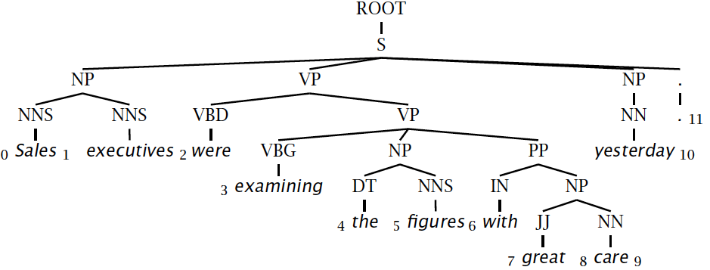
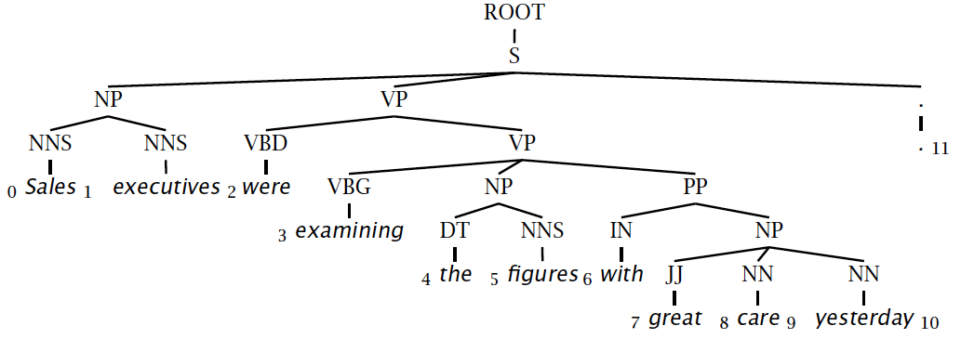
Evaluating constituency parsing
Notes:
Most sentences are not given a completely correct parse by any currently existing parser.
A constituent is a triple, which must be exact in the true parse for the constituent to be marked correct.

Slide 68
Evaluating constituency parsing
Gold standard brackets:
S-(0:11), NP-(0:2), VP-(2:9), VP-(3:9), NP-(4:6), PP-(6-9), NP-(7,9), NP-(9:10)
Candidate brackets:
S-(0:11), NP-(0:2), VP-(2:10), VP-(3:10), NP-(4:6), PP-(6-10), NP-(7,10)
Labeled Precision 3/7 = 42.9%
Labeled Recall 3/8 = 37.5%
LP/LR F1 40.0%
Tagging Accuracy 11/11 = 100.0%
Notes:
This isn’t necessarily a great measure … me and many other people think dependency accuracy would be better.

Slide 69
How good are PCFGs?
Penn WSJ parsing accuracy: about 73% LP/LR F1
Robust
  Usually admit everything, but with low probability
Partial solution for grammar ambiguity
  A PCFG gives some idea of the plausibility of a parse
  But not so good because the independence assumptions are too strong
Give a probabilistic language model
  But in the simple case it performs worse than a trigram model
The problem seems to be that PCFGs lack the lexicalization of a trigram model

Slide 70
Constituency Parser Evaluation

